Slide 1
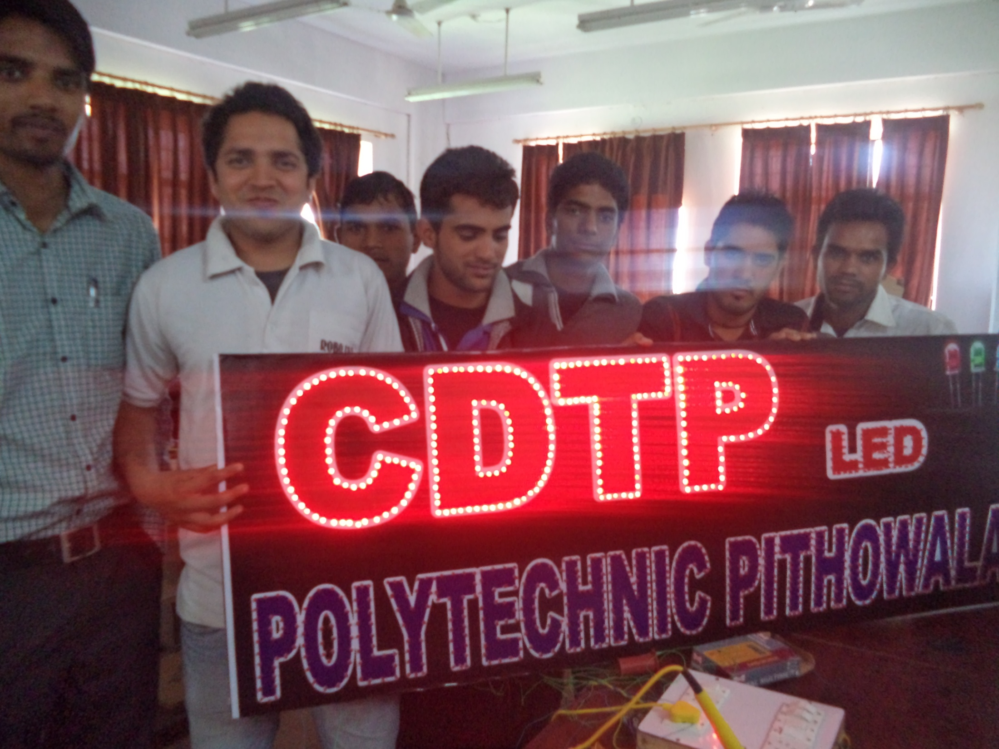
Review of CDTP Scheme of Government Polytechnic Dehradun

Slide 2
Executive Committee Meeting

Slide 3
Physical Achievements
No. of Skill Development Training Programmes | 06 | Data Entry & Smart Office Management Computer Hardware Networking Electrical Appliance Repair & House Wiring Automobile Body & Paint Repair LED Display Fabrication & Repairing AC & Refrigerator Repairing
No. of Extension Centres setup | 07 | Disha Computer Institute, Mehuwala Delite Engg. Institute, Mulchand Inclave, Shimla Chowk, Dehradun Scholars Computer Institute, Near Rajarammohan Rai, School, Dehradun Panchayat Bhwan, Chak Tuknwala, Dehradun Pratap & Sons, Chaman Vihar GMS Road, Dehradun
No. of persons Trained | 223
No. of persons employed | 41
No. of person still undergoing training | 158 | Data Entry & Smart Office Management Computer Hardware Networking Electrical Appliance Repair & House Wiring

Slide 4
Dissemination and Application of Appropriate Technologies
GPD involved various agencies and organizations in this programme so that appropriate technologies can be disseminated systematically in the rural areas.
 | Technology | Villages Covered | No of Benefi- Ciaries | organizations involved
1 | Solar Energy | 09 | 54 | Various firms related to Solar Energy in the exhibition(Sri Solar etc.)
2 | Energy Efficiency | 05 | 43 | GPD
3 | Bee Keeping | 08 | 55 | Horticulture & Food Processing Dept. Dehradun Bagwan Gramodhog Samiti, Aambiwala
4 | Vermi Compost | 05 | 10 | Environment & Ecological Dept., FRI Dehradun
5 | Mushroom Cultivation | 03 | 14 | Bagwan Gramodhog, Forest Pathology Dept., FRI Dehradun

Slide 5
Technical Support Services
GPD conducted 05 repairing camps in mother and extension centres in which free services provided by CDTP trainees. They actively participated in the programme and provided better free technical services to the rural people.
S.N. | Technology | Villages Covered | No of Benefici-aries | Venue, where camp organized
1 | Electrical Repair | 03 | 68 | Pithuwala, Chak Tunwala,
2 | Sewing Machine Repair | 01 | 45 | Chnadrabani
3 | Computer Repair | 01 | 24 | Mehuwala

Slide 6
Dissemination of Information
S.N. | Technology | Villages Covered | No of Beneficiaries
1 | Self Employment & Training | 16 | 187
2 | Disaster Management | 07 | 90
3 | Community Mela | 23 | 149
4 | Internet | 04 | 39
5 | Organic Farming | 04 | 45

Slide 7
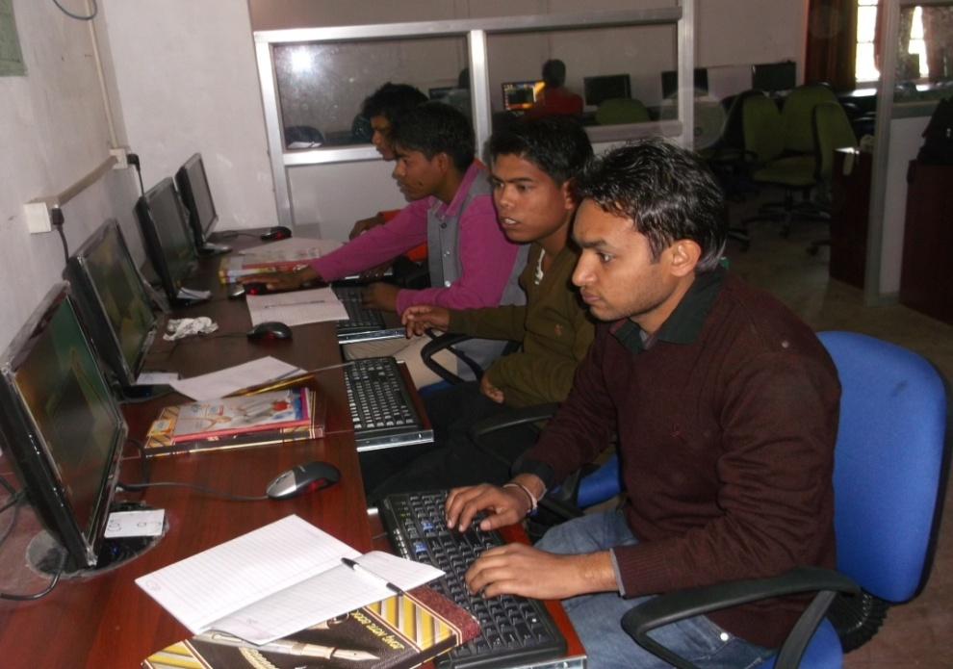
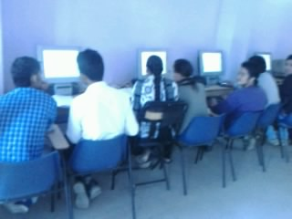
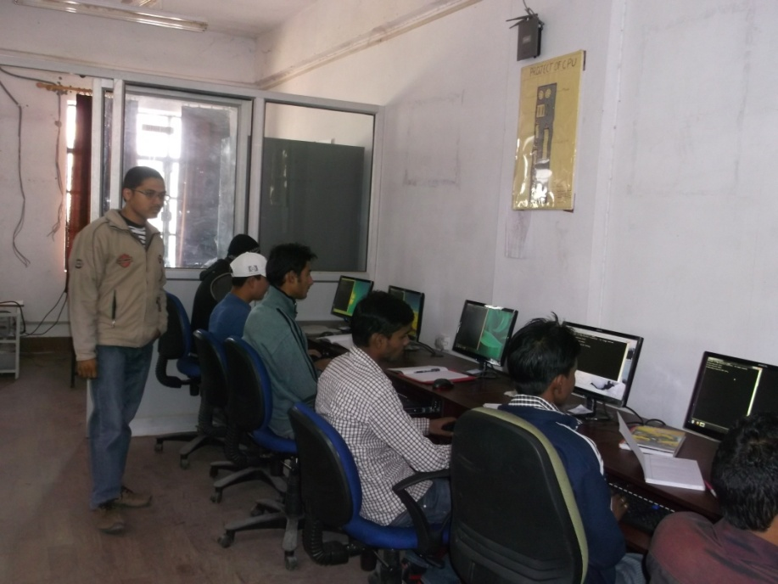
Skill Development Training Programme 1. DATA ENTRY & SMART OFFICE MANAGEMENT

Slide 8
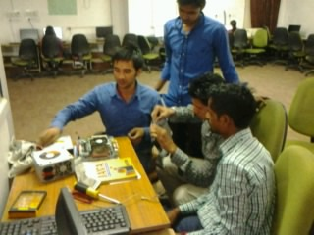
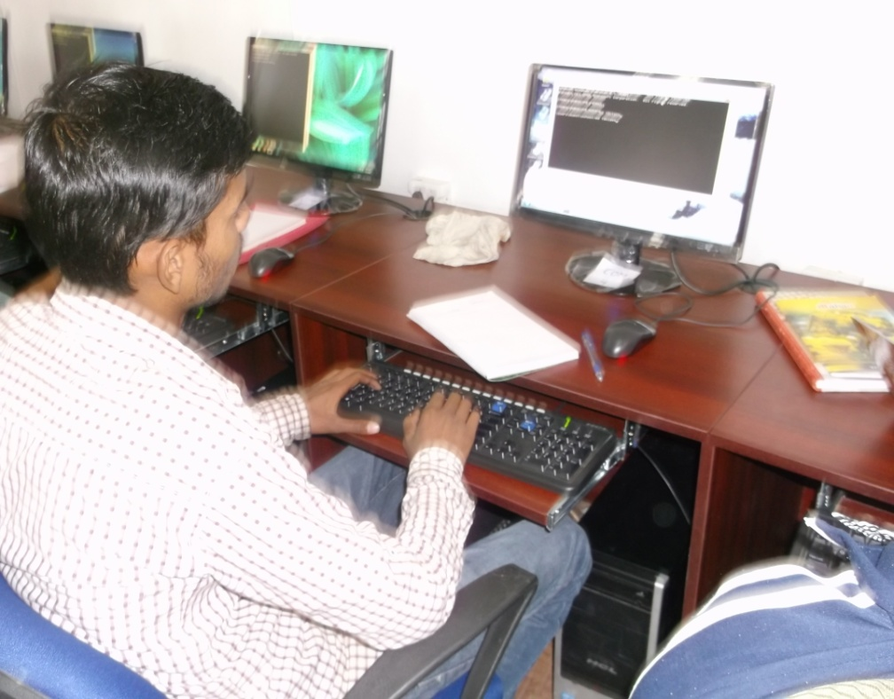
2. COMPUTER HARDWARE & NETWORKING

Slide 9
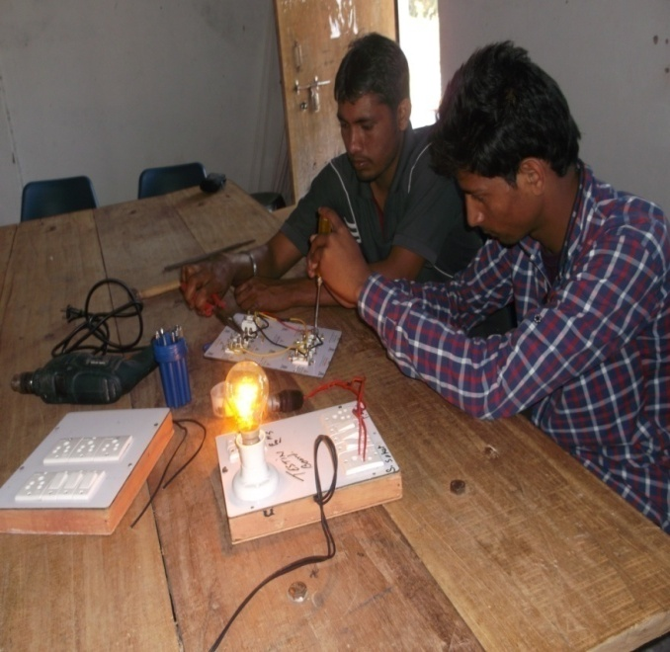
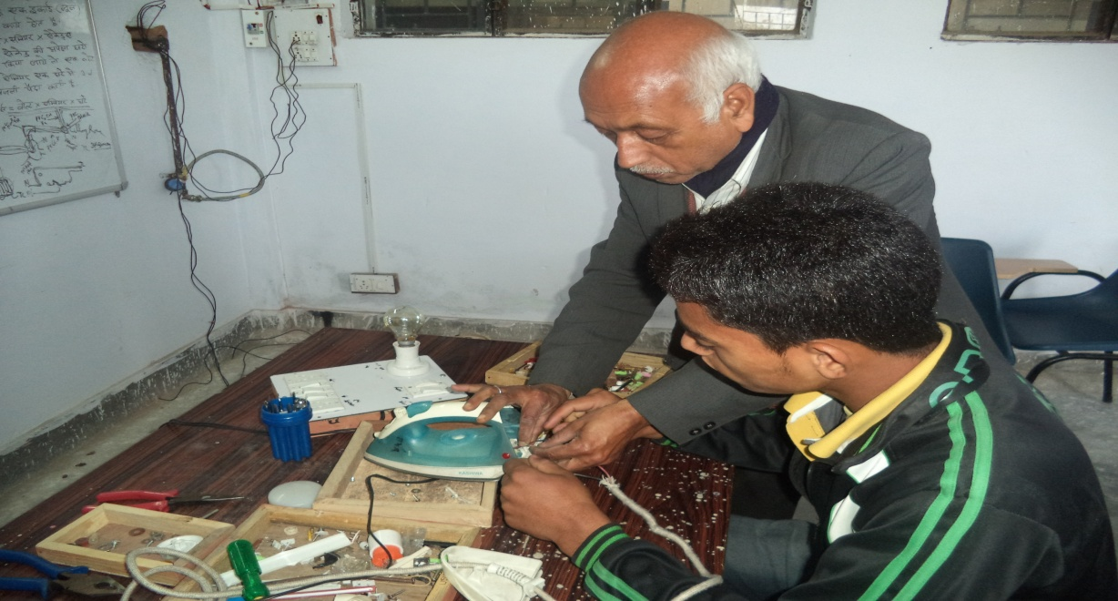
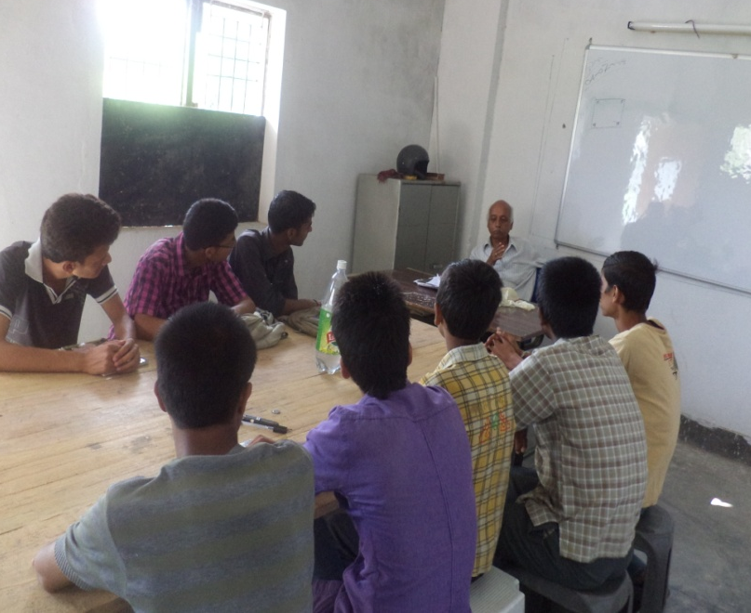
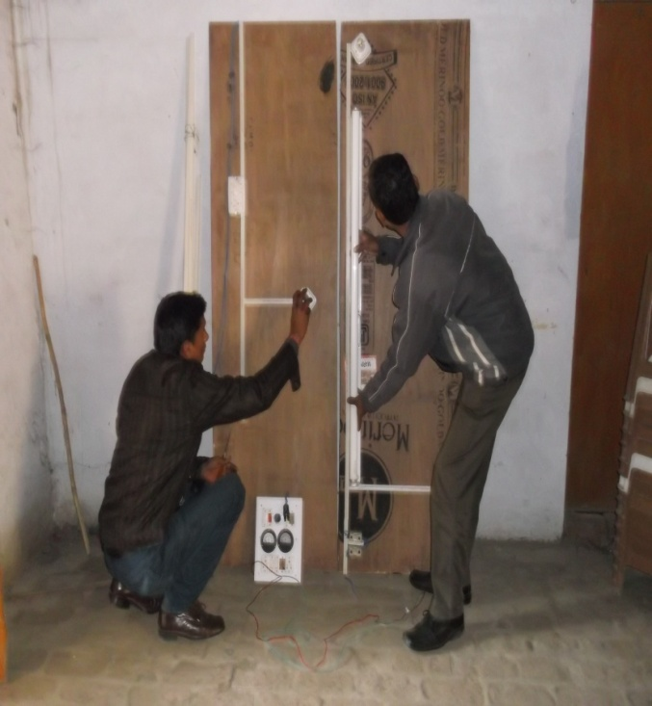
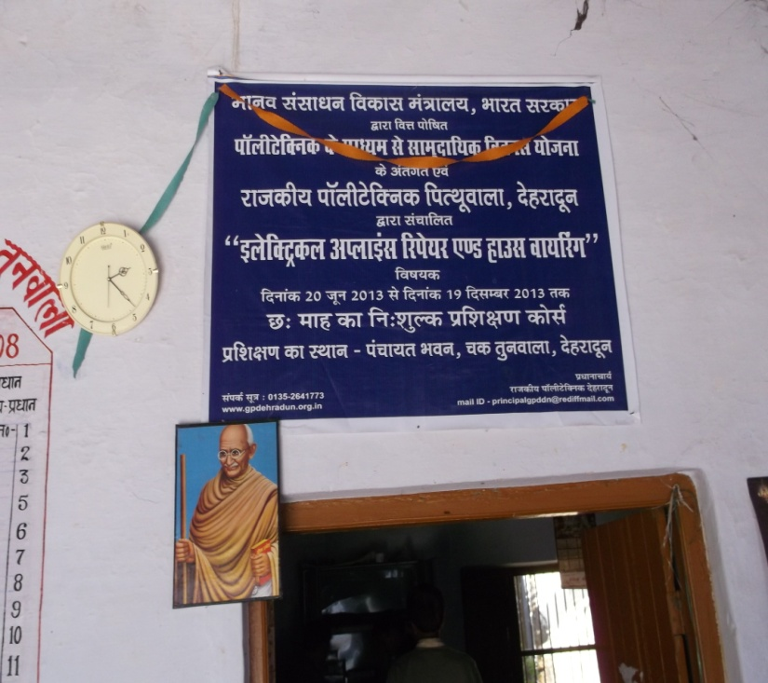
3. ELECTRICAL APPLIANCE REPAIR & HOUSE WIRING

Slide 10
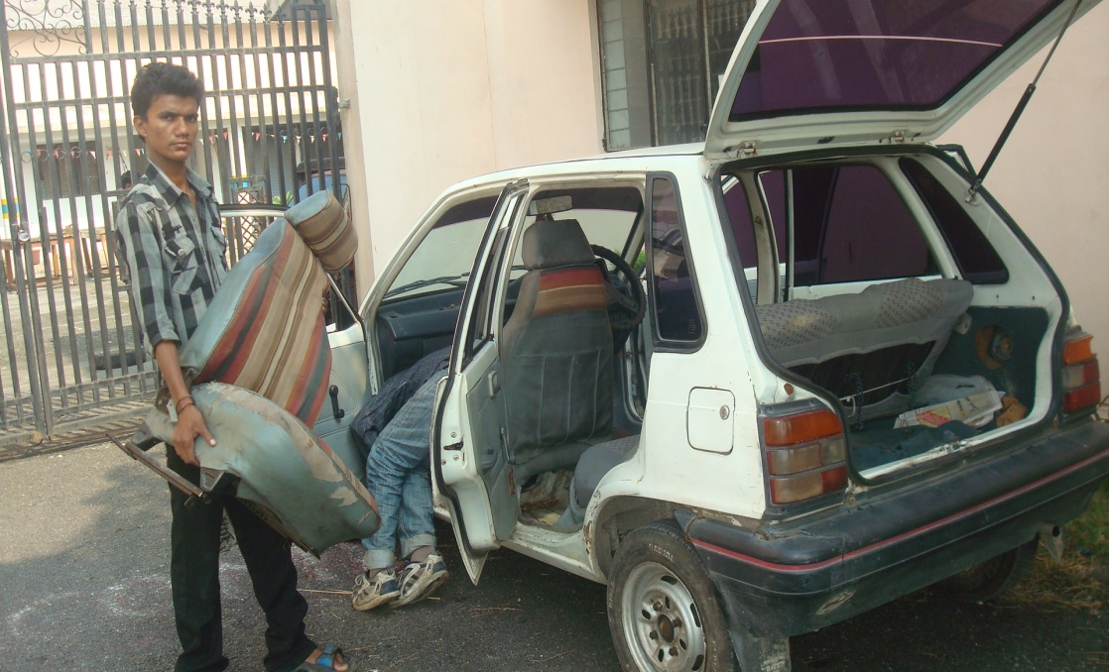
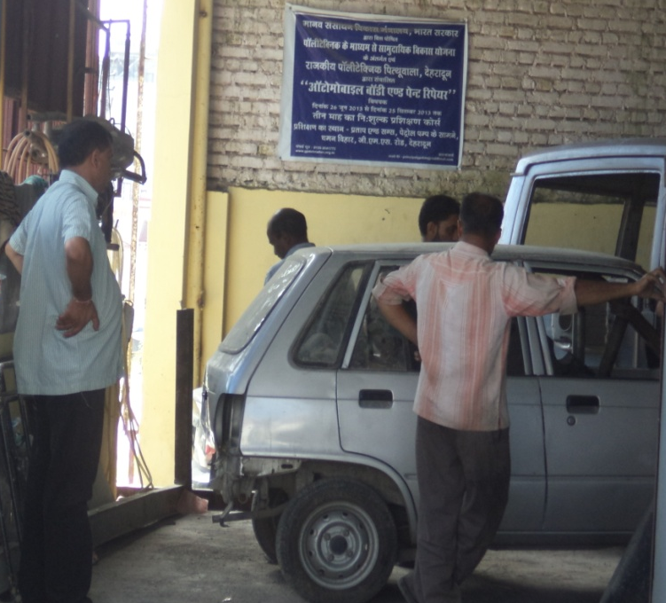
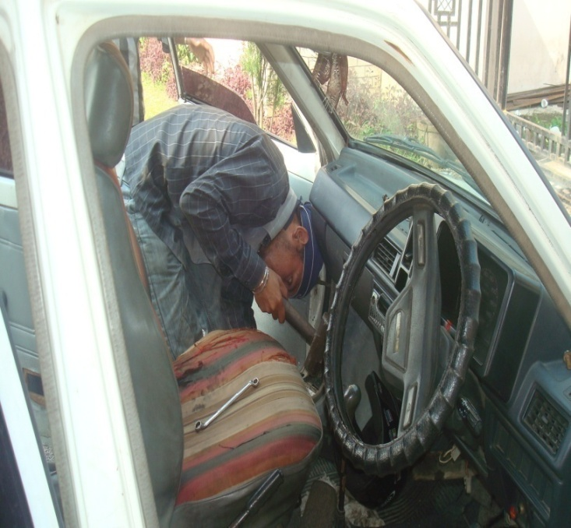
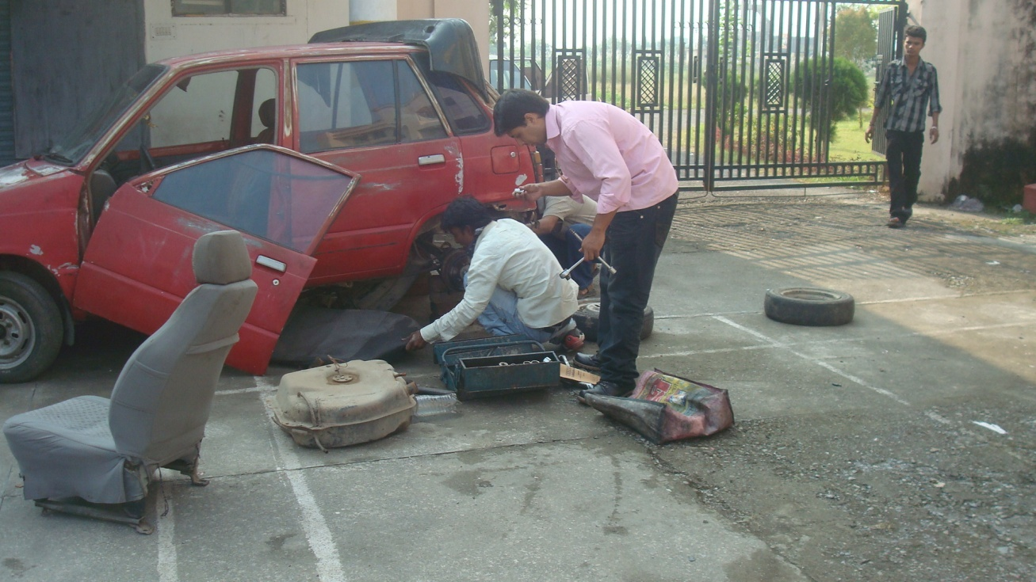
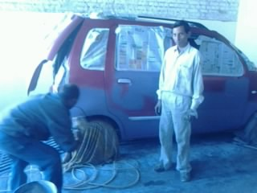
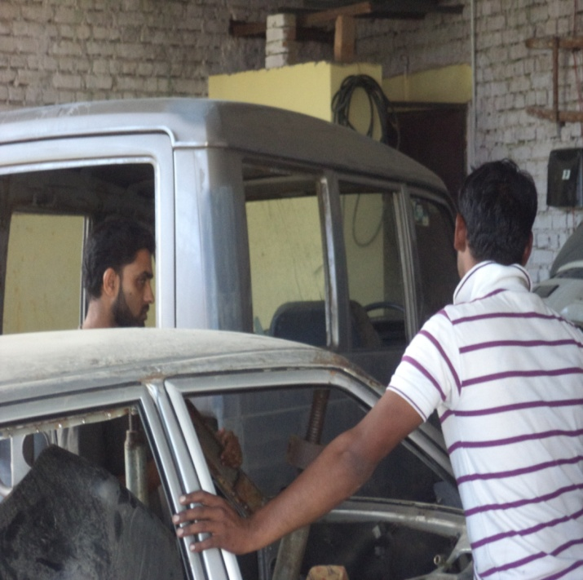
4. AUTOMOBILE BODY & PAINT REPAIR

Slide 11
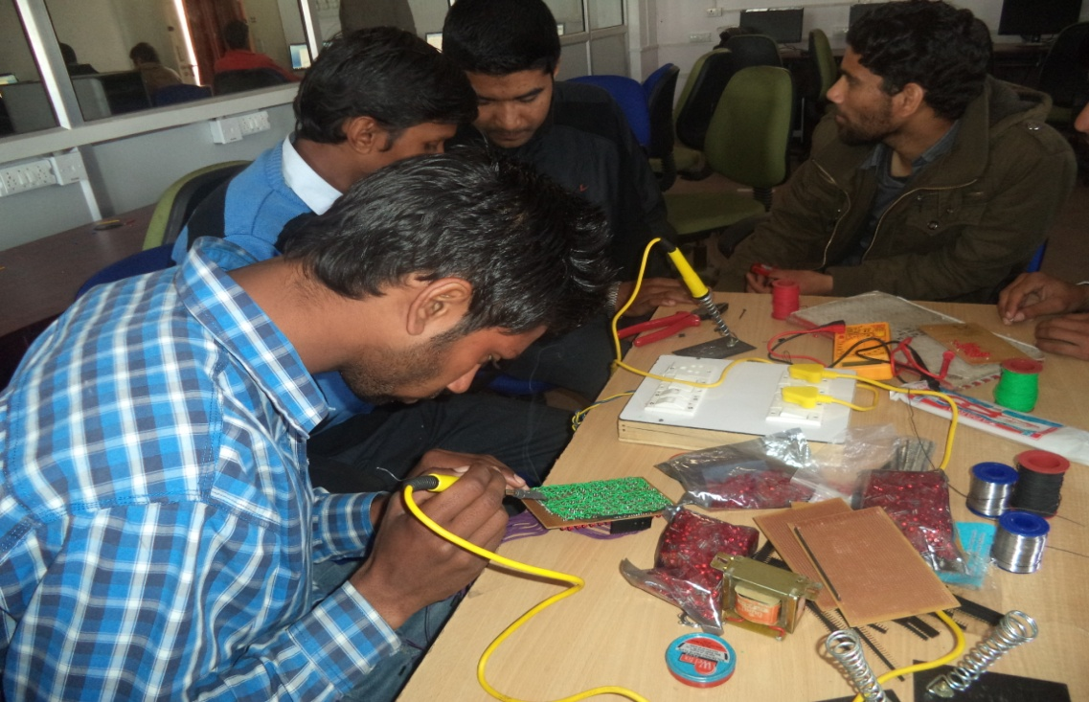
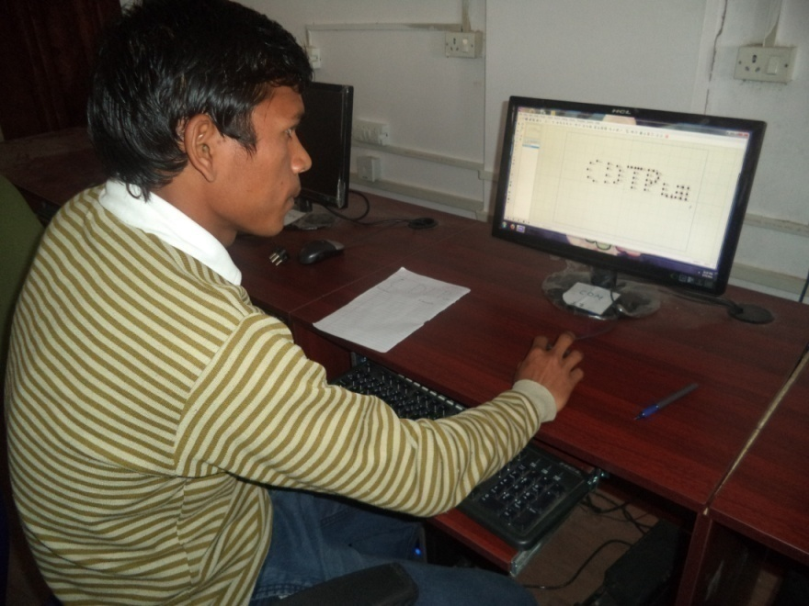
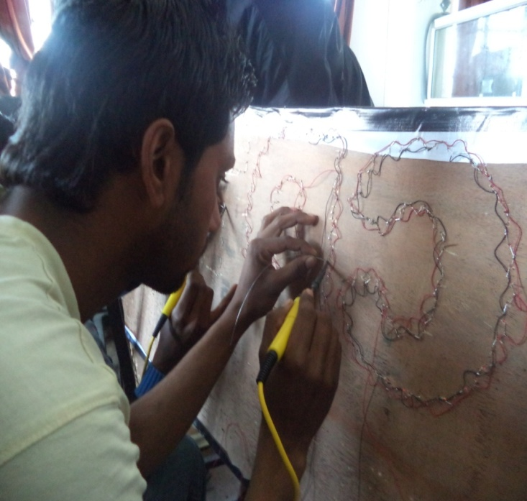
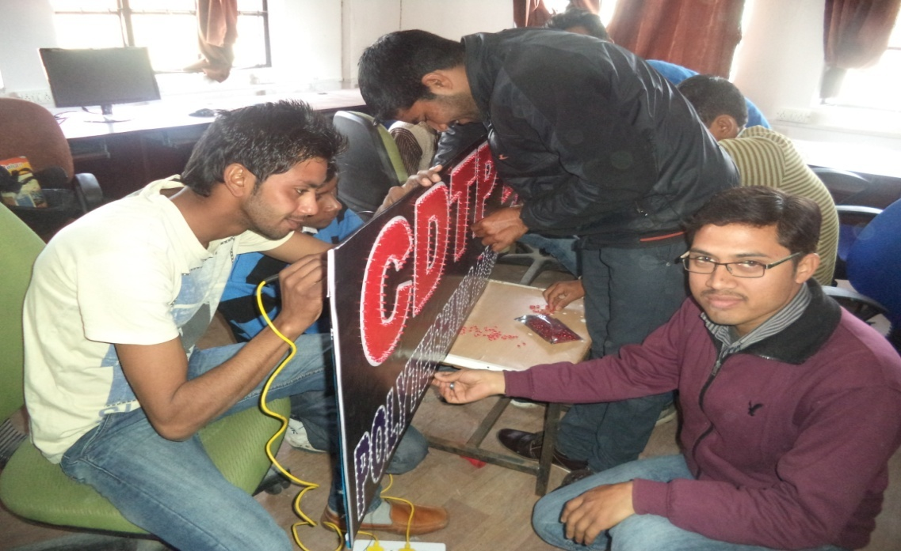
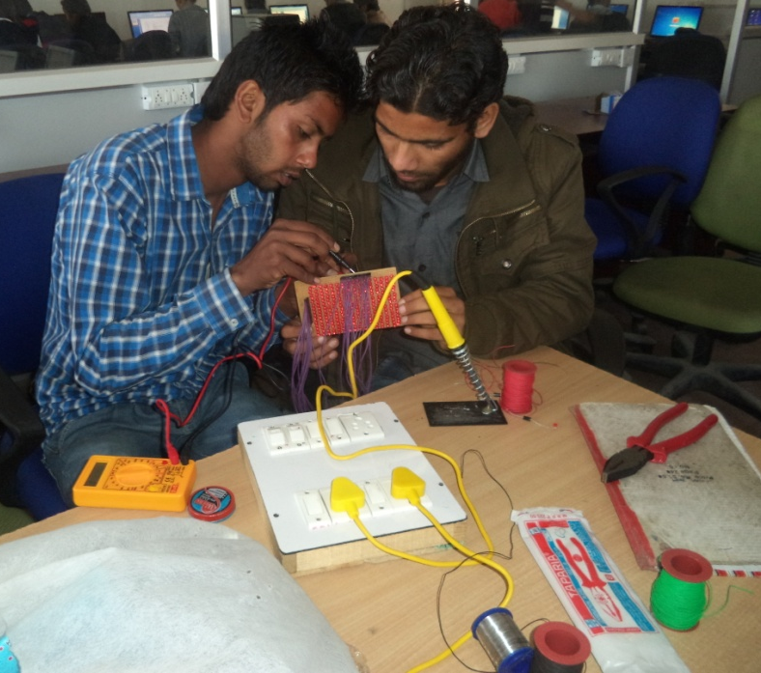
5. LED DISPLAY FEBRICATION & RAPAIRING

Slide 12
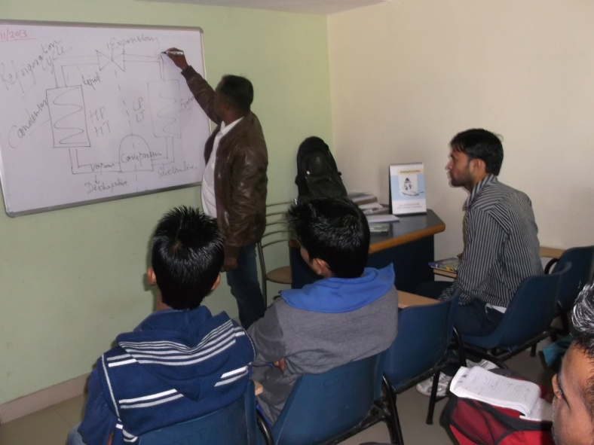
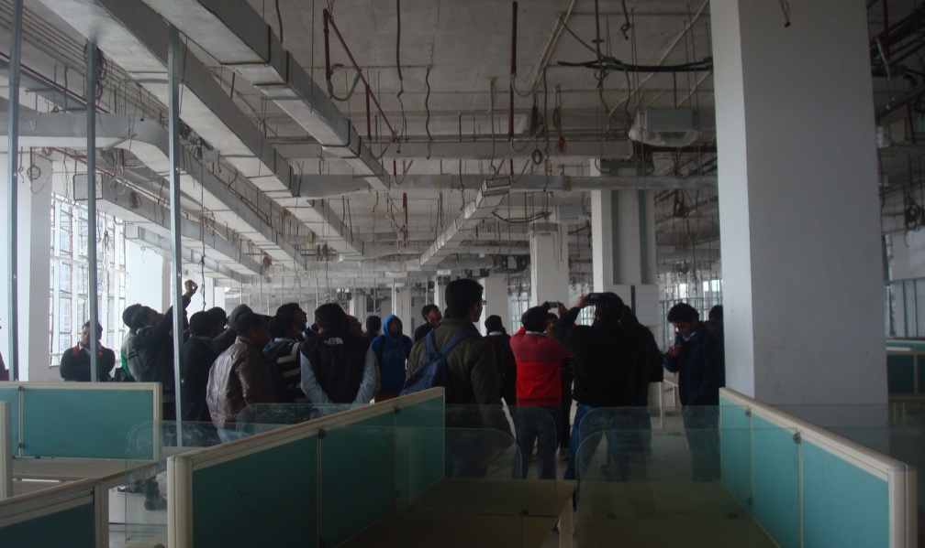
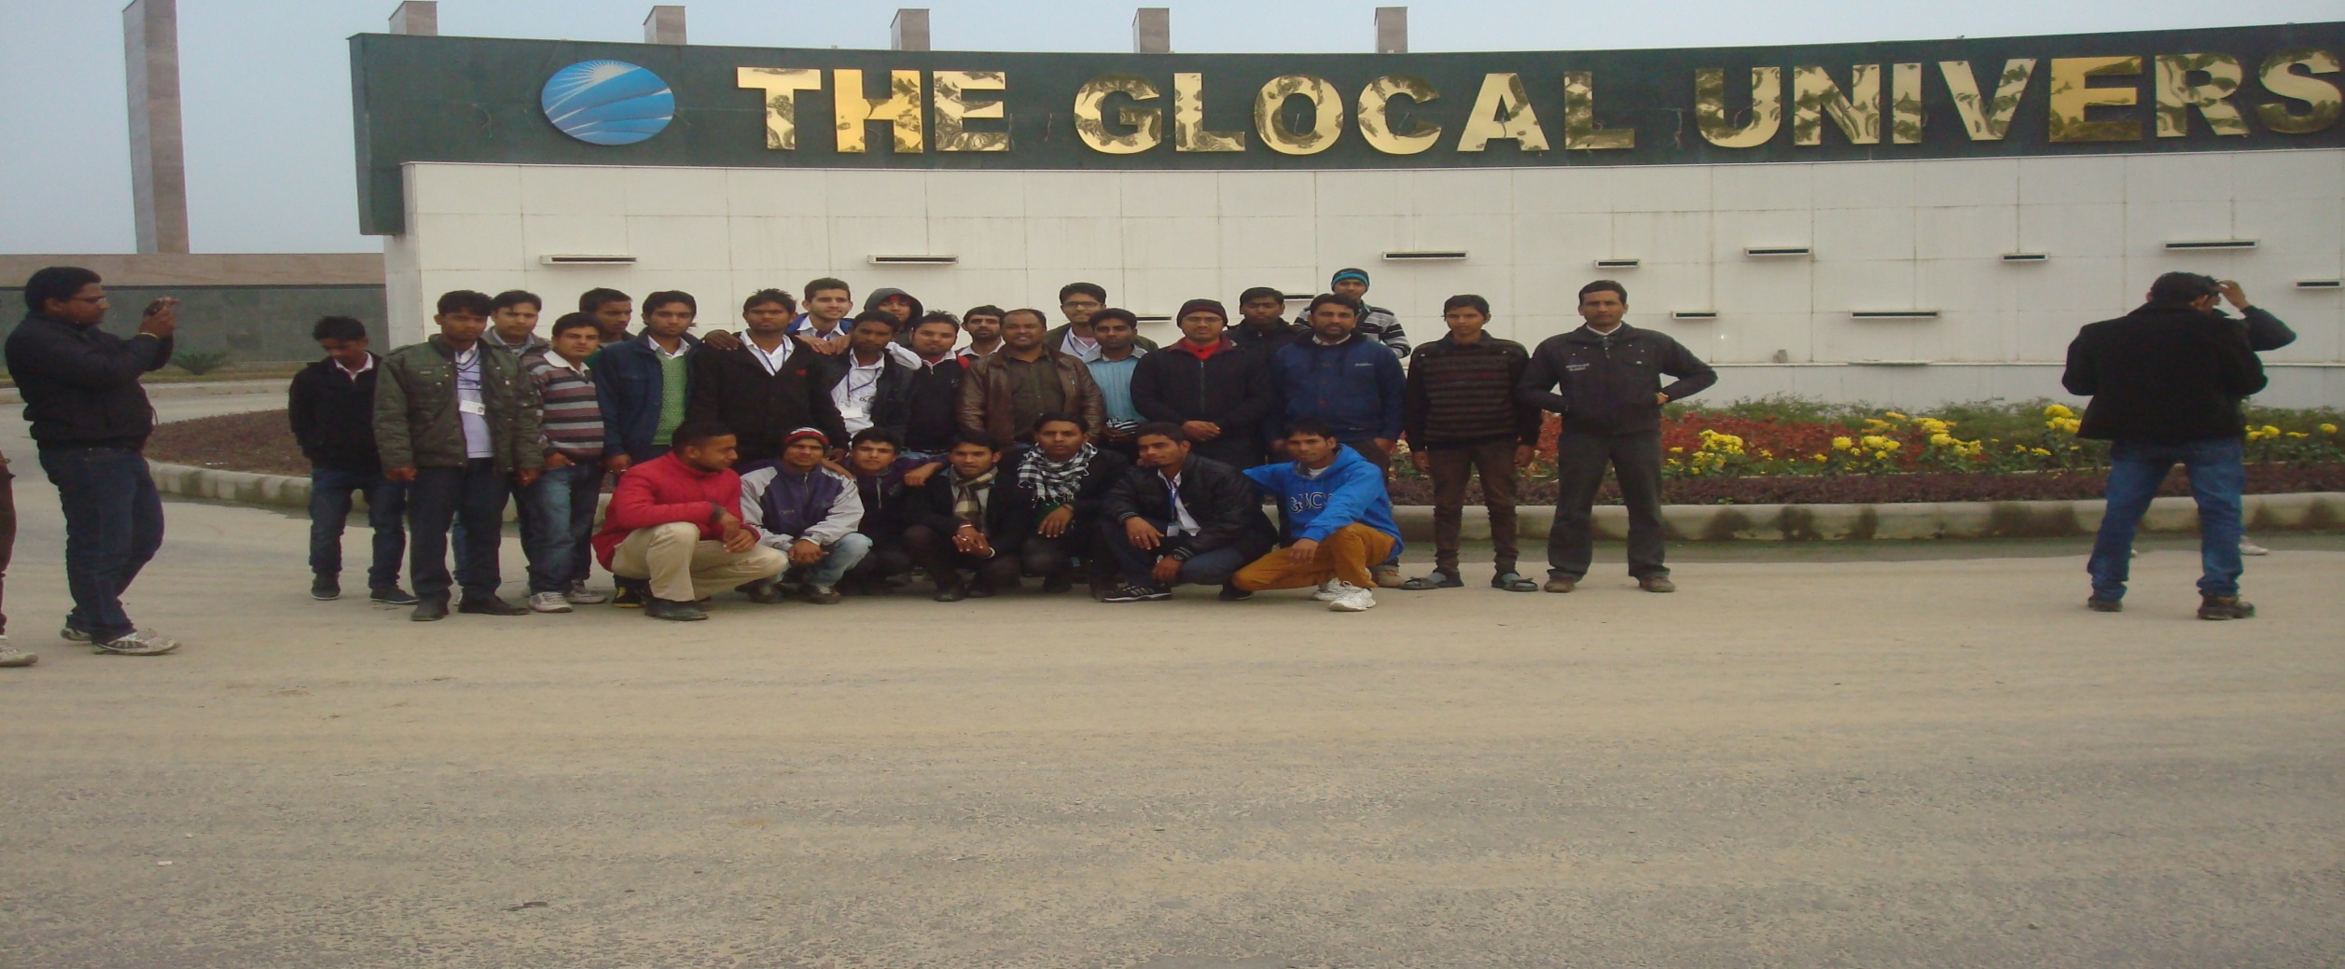
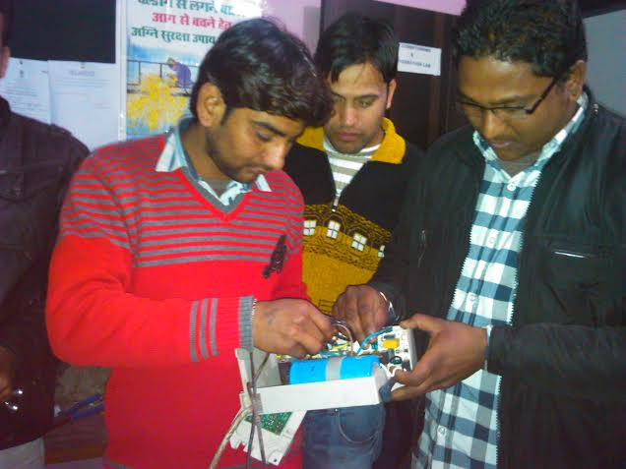
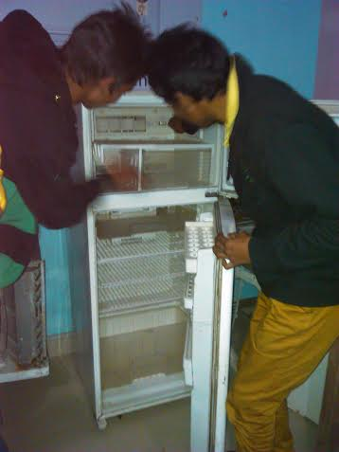
6. AC & REGRIDGERATOR REPAIR
Education Tour
Educational Tour in Glocal University

Slide 13
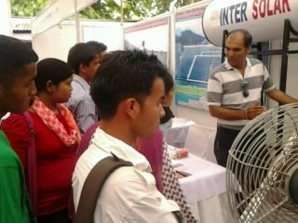
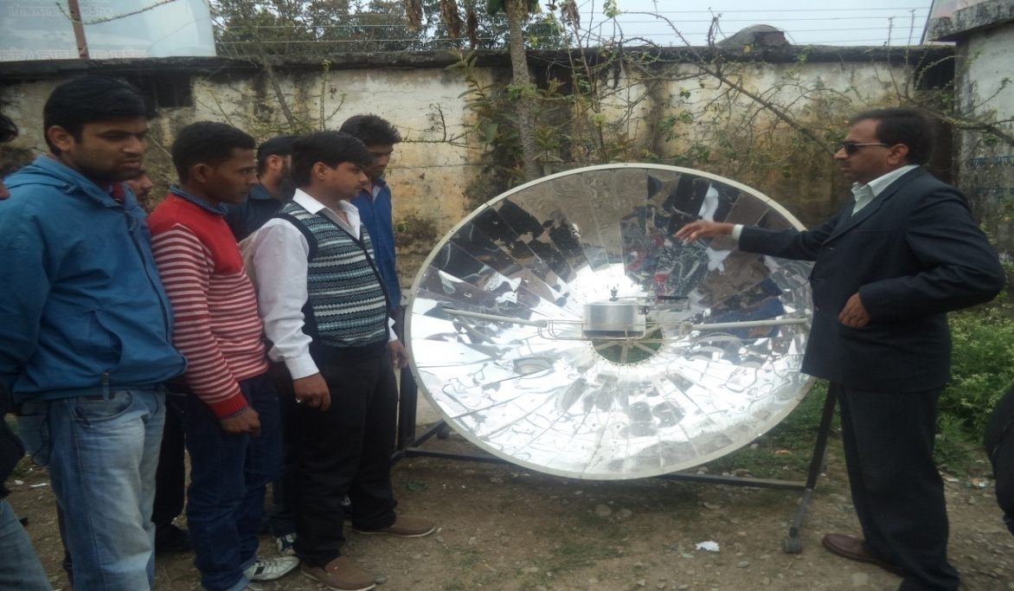
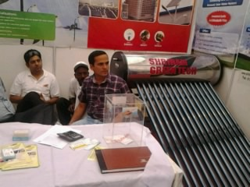
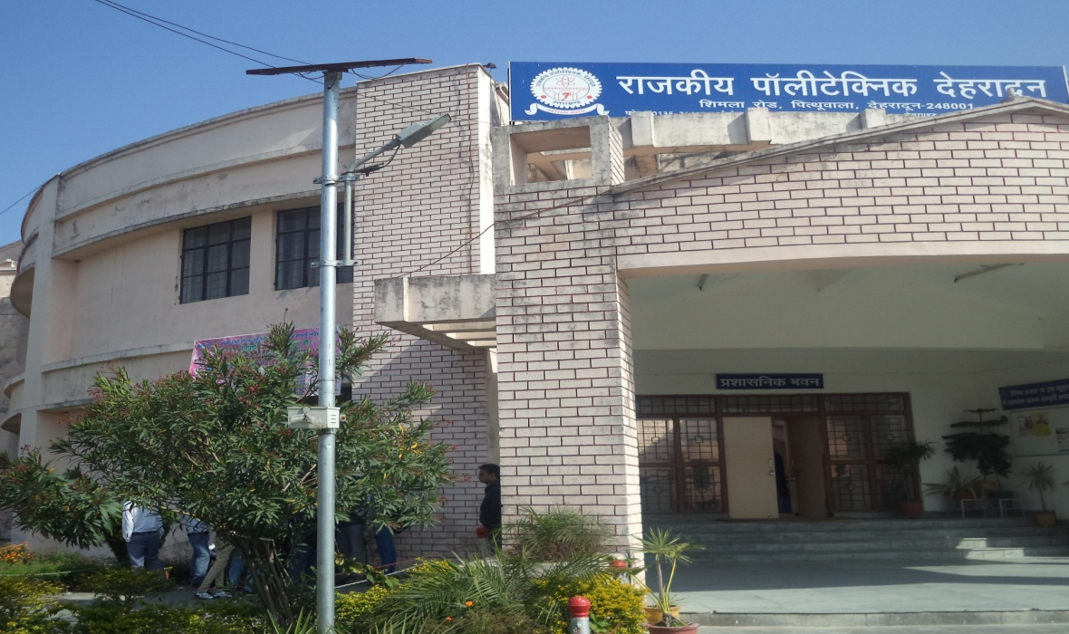
Transfer of Technology Solar Energy
Solar Street Light installed in the Institute

Slide 14
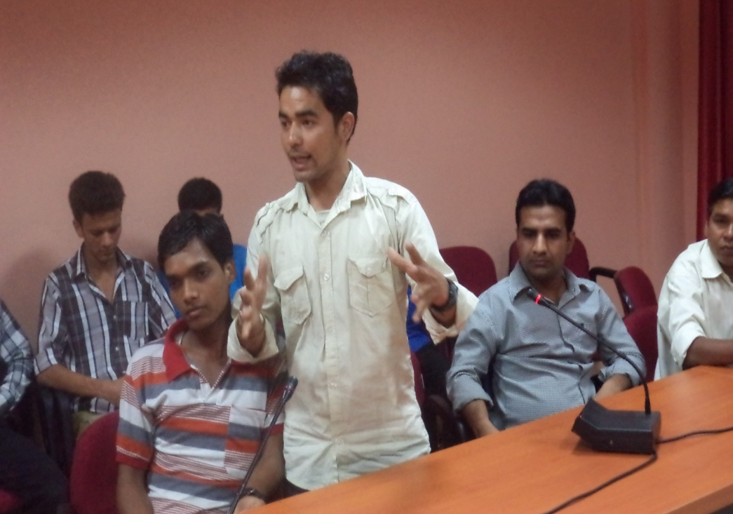
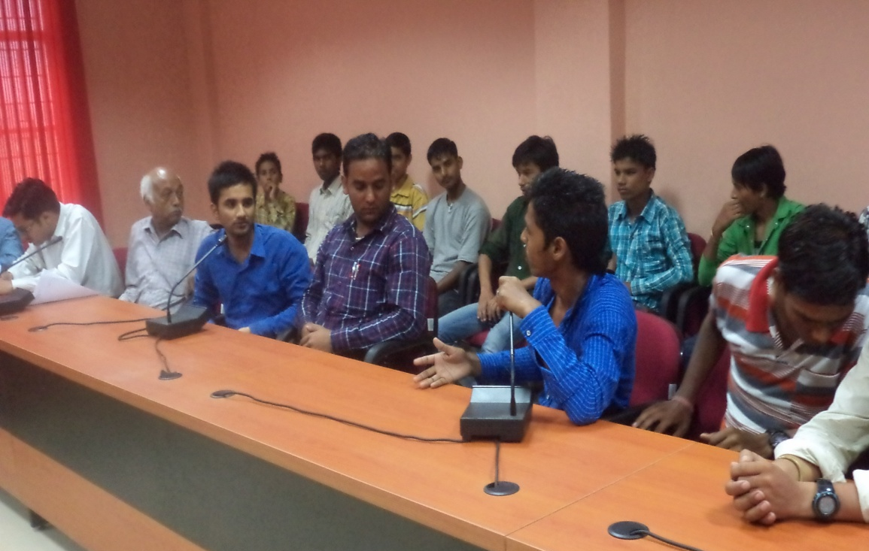
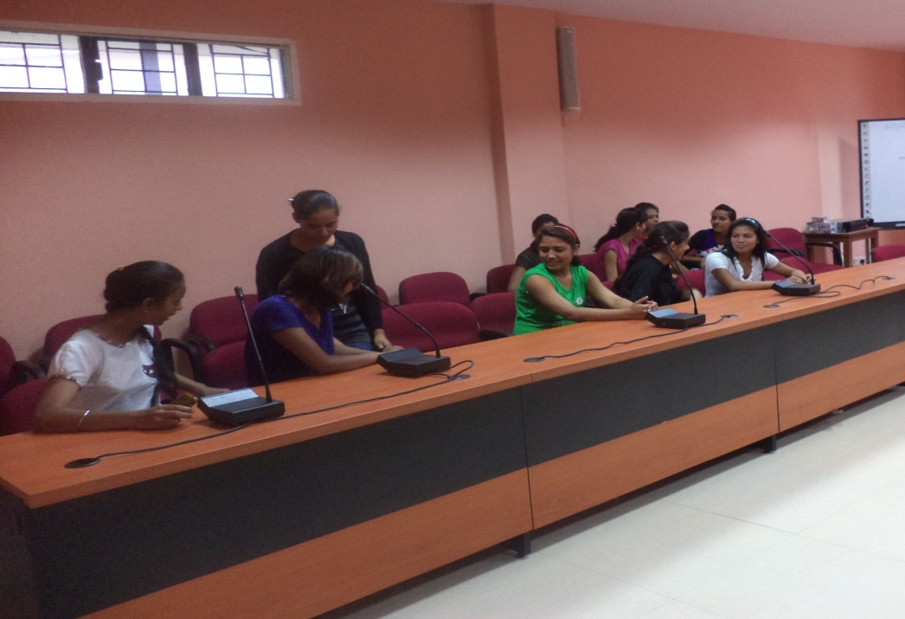
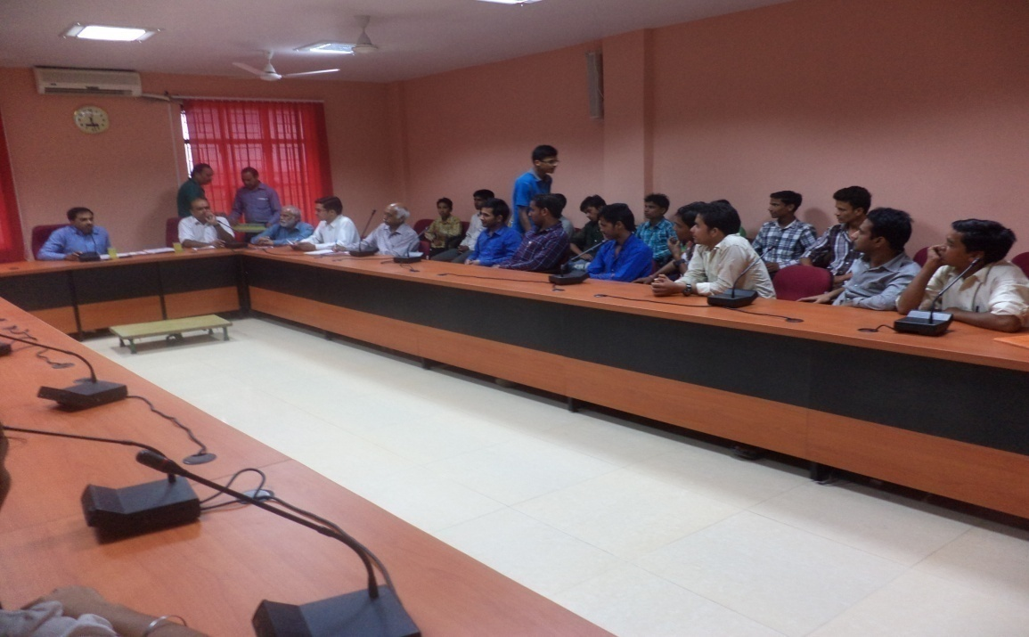
Energy Efficiency
Awareness Programme on Energy Efficiency and Group discussion

Slide 15
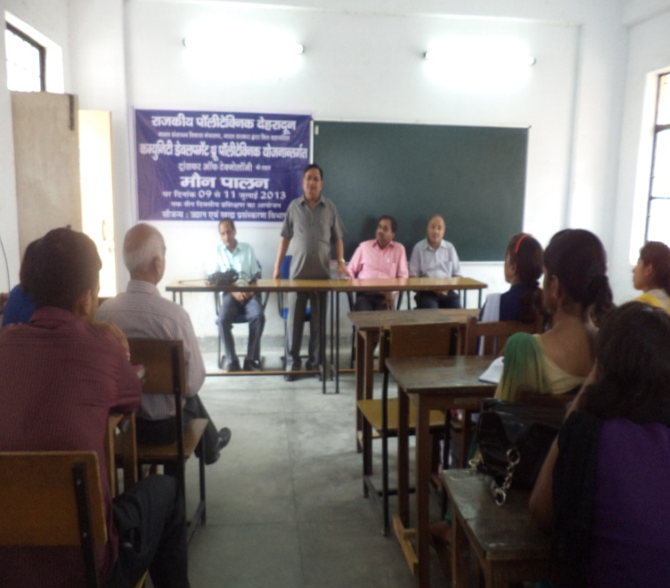
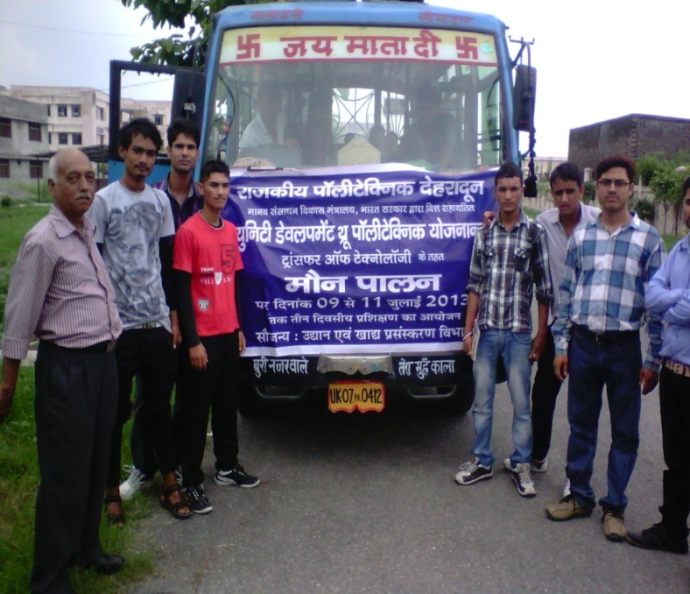
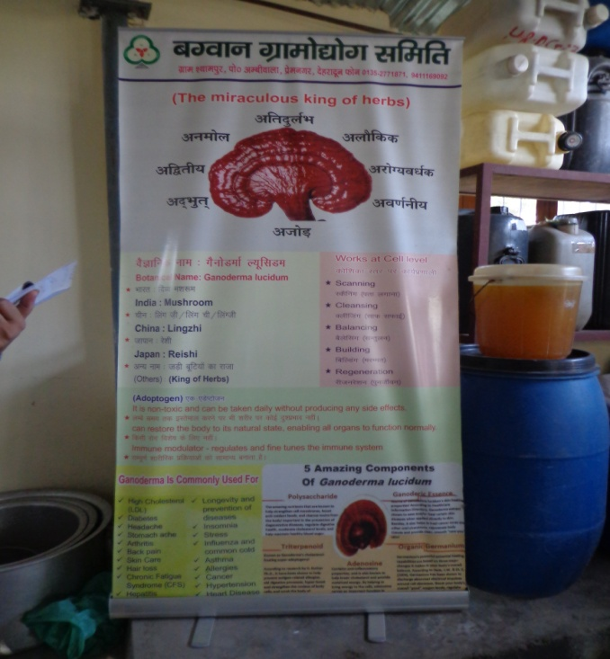
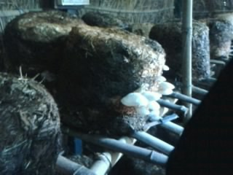
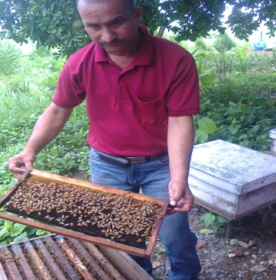
Bee Keeping & Mushroom Cultivation
Training on Bee Keeping
Visit on Mushroom Cultivation
Training on Bee Keeping

Slide 16
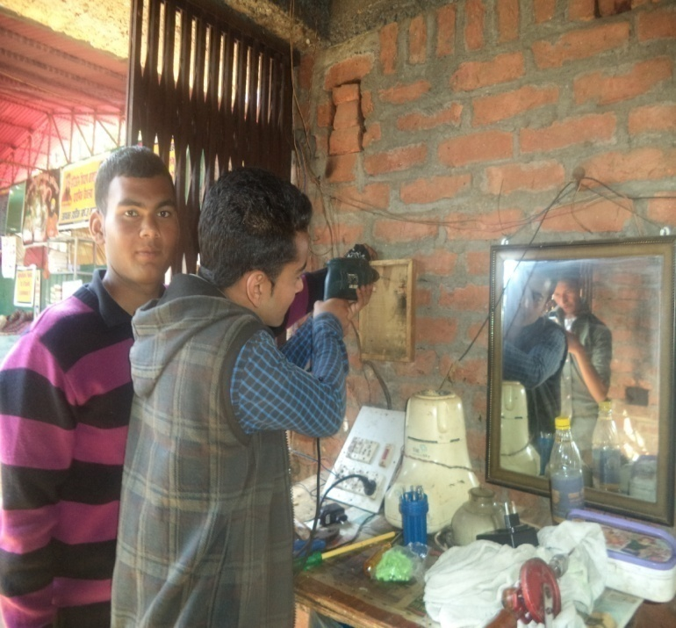
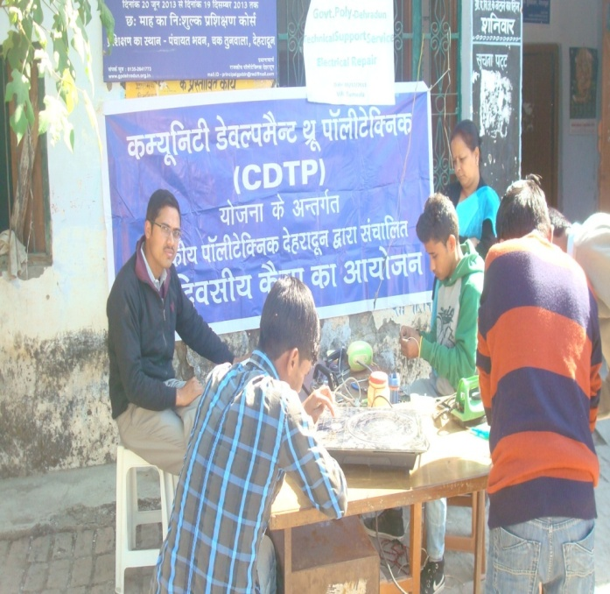
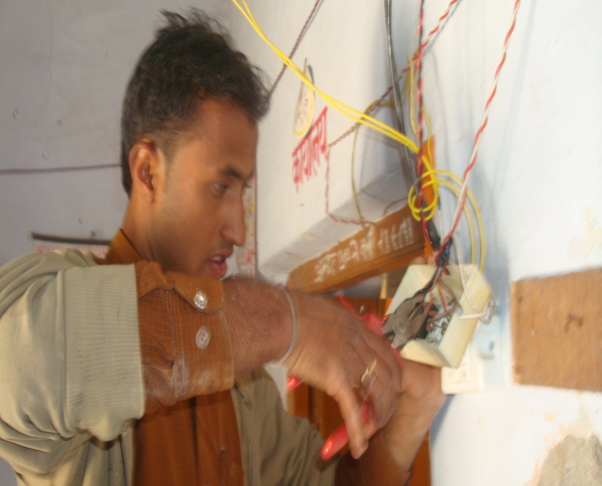
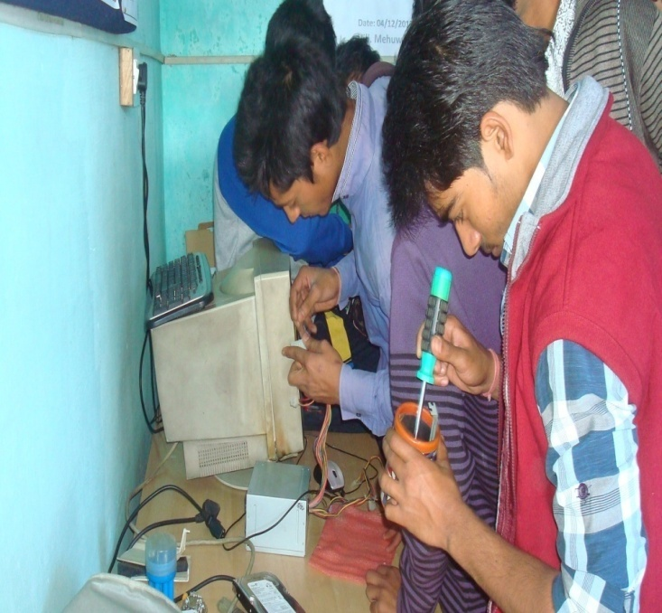
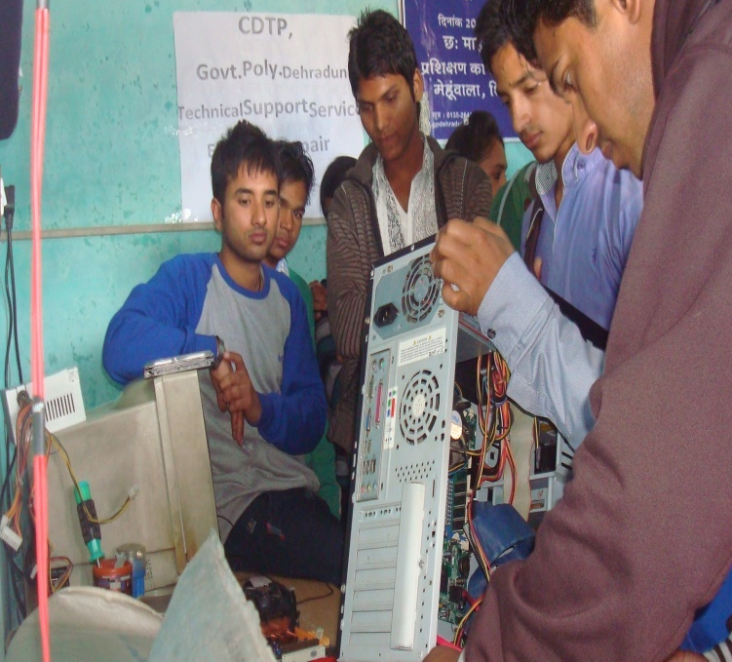
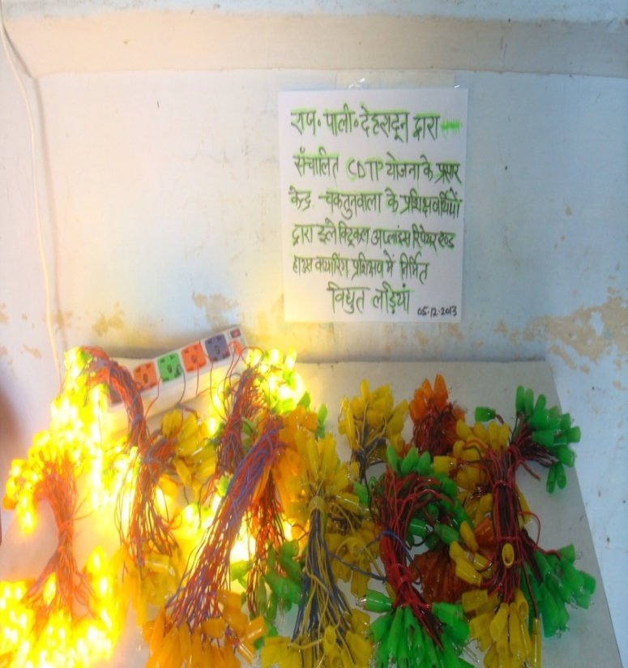
Technical Support Services Electrical Repair & Computer Repair
Electrical Repair camp in Bhuddi
Electrical Repair camp Tunwala
Computer Repair camp in Mehuwala
Prepared by Electrical house wiring students in Tunwala Centre

Slide 17
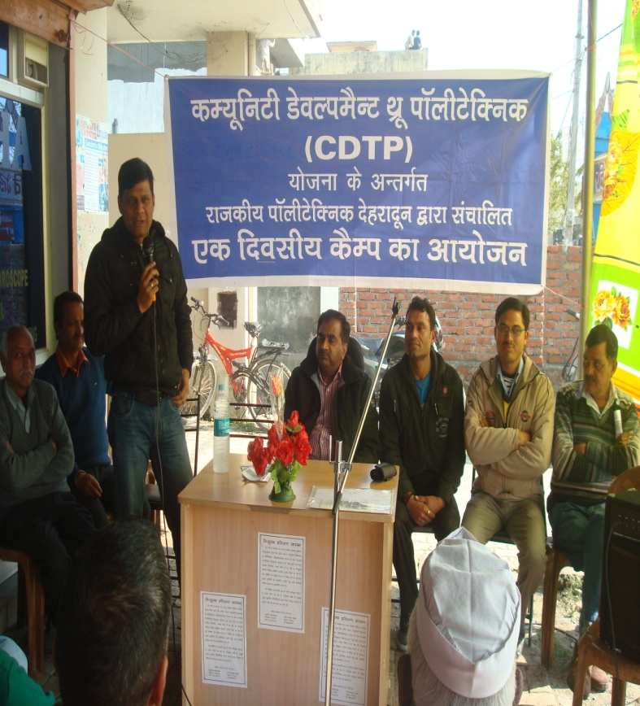
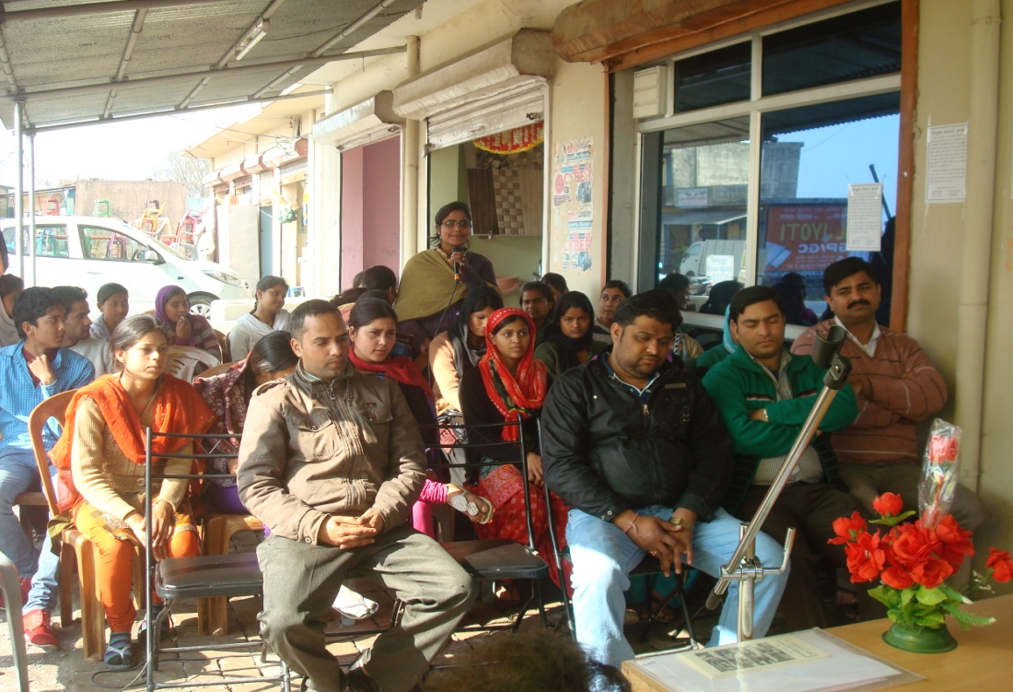
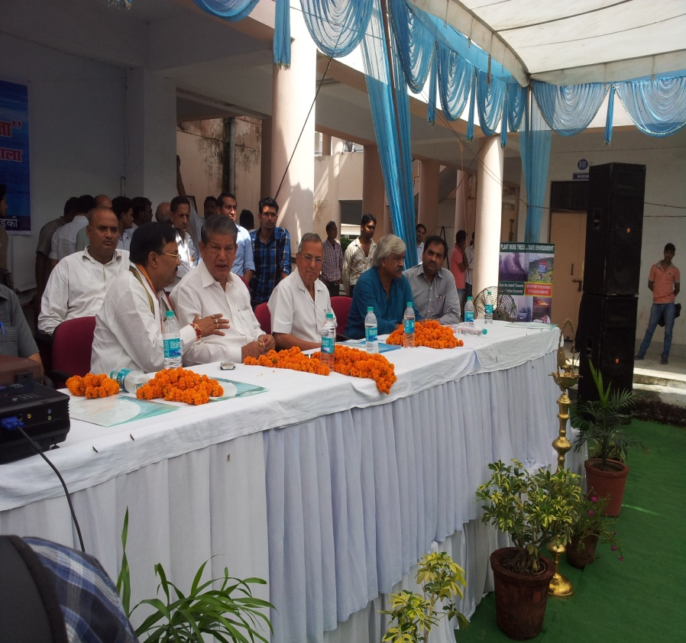
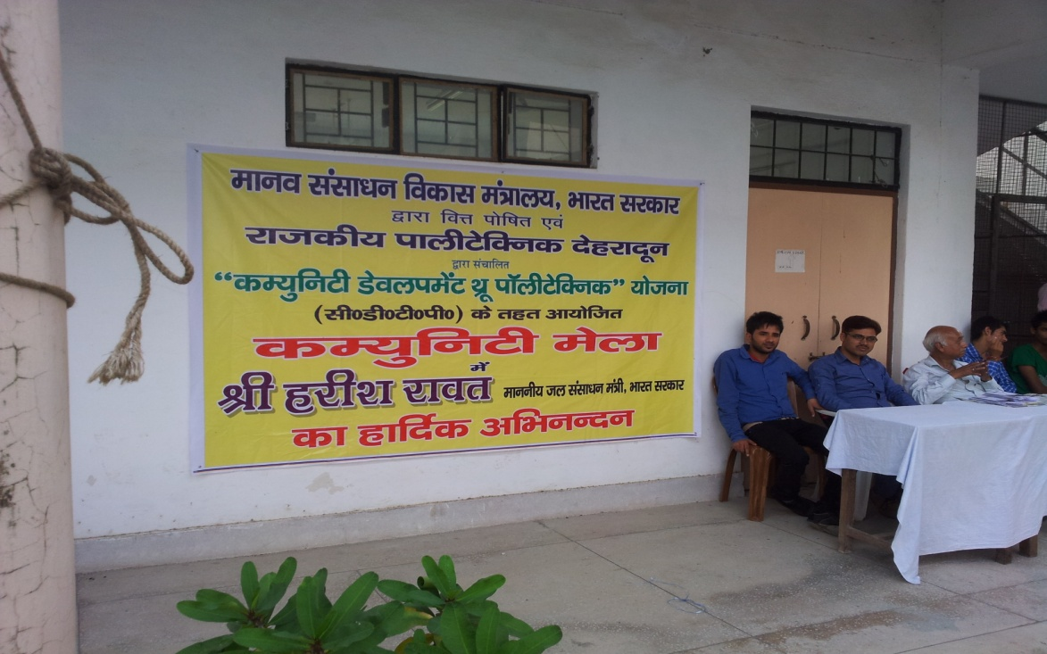
Awareness Programme Organic Farming/Community Mela
Organic farming
Community Mela

Slide 18
Self Employment & Training/Disaster Management/Internet
Self Employment & Training
(Asstt. Director KVIC addressing to participants)
Self Employment & Training
Internet)
Disaster Management
(at IEI, State Centre, Dehradun)
Awareness Prog. on Disaster Mngt.
(in GPD Confrencxer Hall)

Slide 19
Other Activities for Development
Other Activities for CDTP trainees
15 Days EDP Training | NIESBUD
Polythene Eradication | Camp in GPD
Financial Education | Workshop by SEBI Certified trainer
Sports | Sports Competition
Training on Prefabricated Building Components | Field Visit in IEI, state centre, Dehradun Uttarkhand
Farewell Programme | Tunwala, Delite Engg. School

Slide 20
Other Activities
CDTP Sports
Awareness Programme on Financial Education
Polythene Eradication
CDTP Farewell organised by Electrical Students in Tunwala

Slide 21
Extra Technology Transfered
Prefabricated House
Bamboo house
Bamboo house
Prefabricated Toilet

Slide 22
Advisory Committee Meeting

Slide 23
Linkage Developed in 2013-14 for employment/self-employment purposes
Tirupati Group of Industries
Rawat Industry
Khadi Gramodhog Aayog, Dehradun
DIC Dehradun
Asstt. Electrical Inspector, Laxman Chowk, Dehradun
ISON Pvt. Ltd. Subhash Nagar Dehradun
Gupta Transformers Ltd. Dehradun
Robo Hub, Dehradun
Scholars Itech Computer Institute, Dehradun
Delite Engineering School, Dehradun

Slide 24
Organizations where CDTP beneficiaries are working
S. | Firms | Job
1 | Aptara Pvt. Ltd. Doon Extress park, Industrial Area, Dehradun | Computer Operator
2 | Bhrat Vikas Group, ONGC Colony Dehradun | Electrician
3 | Mona Beauty Parlor, Prem Nagar, Dehradun | Beautician
4 | Herbal Fool Park, Patanjali Yogpeeth, Haridwar | Beautician
5 | Subharti Hospital, Kothra Santor, Dehradun | AC & Freeze Technician
6 | Haier, Raja Road, Dehradun | AC & Freeze Technician
7 | Trans Tech Turnkey Pvt. Ltd. Mumbai | AC & Freeze Technician
8 | Wipro Computer Institute, Indra Nagar, Dehradun | Office Coordinator
9 | Pratap & Sons, GMS Road, Dehradun | Denter & Painter
10 | Ankush Electricals, Dobhal Chowk, Nehrugram, Dehradun (New Self Employment setup) | Self Employed
11 | Negi Electricals, Tunwala, Dehradun (New Self Employment setup) | Self Employed
12 | Mobile Communication, Bhrahmanwala, Majra, Dehradun (New Self Employment setup) | Self Employed

Slide 25
Self Employment
Inauguration of Electrical Repair shop of
CDTP beneficiary at Nehrugram
Electrical Repair shop of
CDTP beneficiary at Gujrowali Chowk, Raipur

Slide 26
Employment of Beneficiaries
41 beneficiaries get employed

Slide 27
Financial Statement
Head | Recurring | Non Recurring
Expenditure in 2013-14 (1 April, 2013 to 14.03.2014) | 7,43,732 | 1,41,993
Unspent balance as on 14.03.2014 | 2,25,235 | 4,28,924
Unspent balance as on 01-04-2013 | 1,69,117 | 5,70,917

Slide 28
CDTP in News Papers

Slide 29
Government Polytechnic Dehradun
principalgpddn@rediffmail.com
www.gpdehradun.org.in

Slide 30
Thank you

